Slide 1

Girls on the Run
Updated Variable Report
Group B: Joely, Matt, Reuben, Tommy, & Tyler

Slide 2
Presentation Outline
Descriptive Statistics
WELL/WELLP
FRIENDS/FRIENDSP
RESPACTS/RESPACTSP
HAPPYAM/HAPPYAMP
T-test Results (Pre vs. Post)
Conclusion
Questions

Slide 3
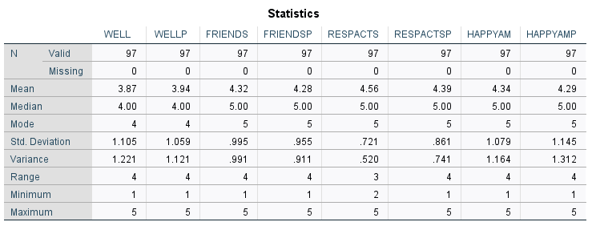
Descriptive Statistics

Slide 4
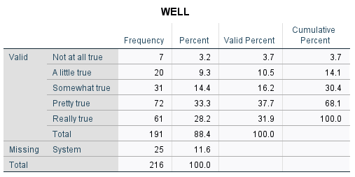
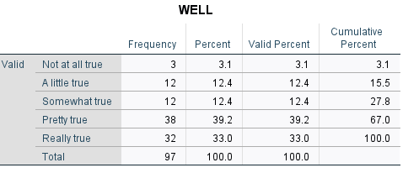
I think I could do well at just about any new physical activity. (WELL)
Pre-survey Results

Slide 5
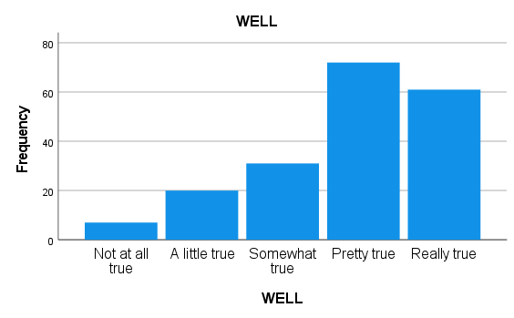
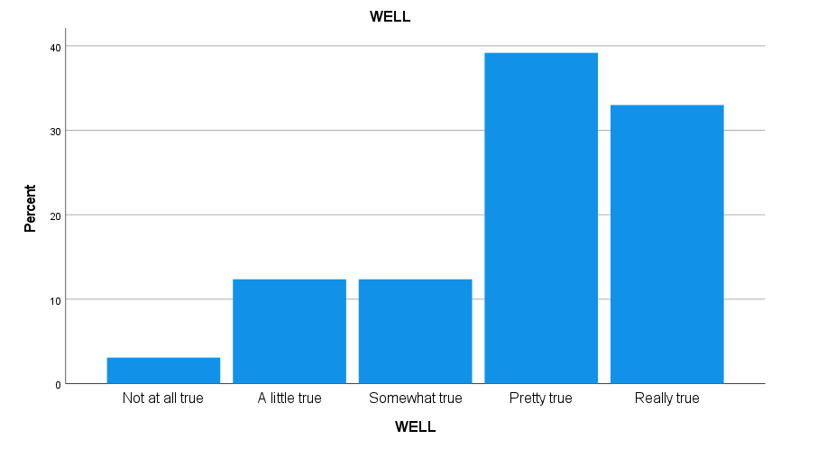
I think I could do well at just about any new physical activity. (WELL)
Pre-survey Results

Slide 6
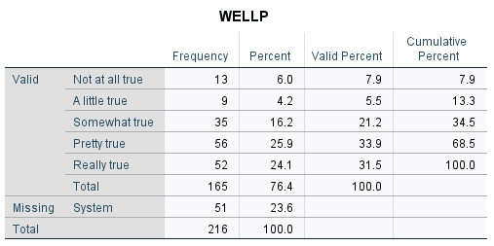
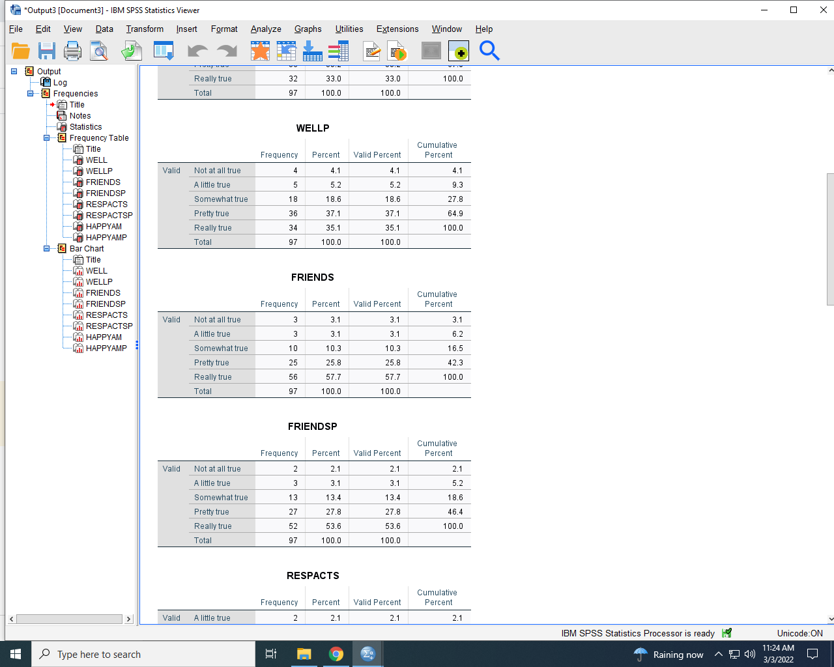
I think I could do well at just about any new physical activity. (WELLP)
Post-survey Results

Slide 7
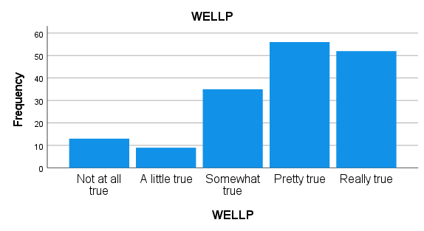
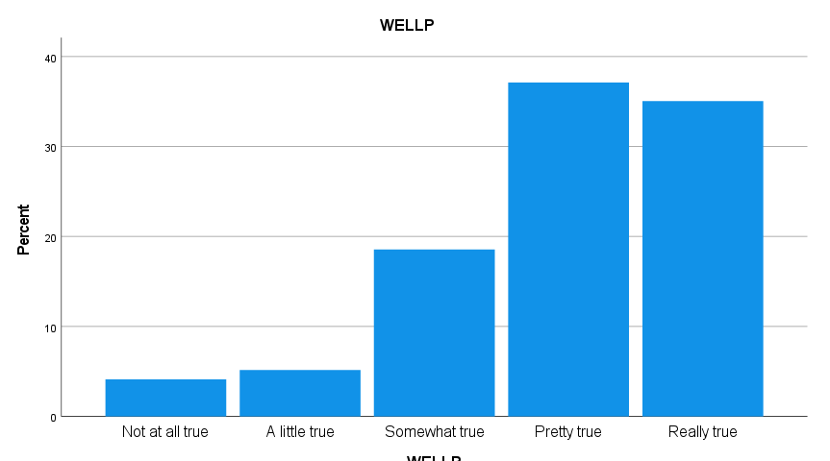
I think I could do well at just about any new physical activity. (WELLP)
Post-survey Results

Slide 8
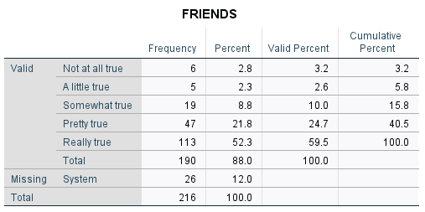
I have classmates I can become friends with. (FRIENDS)
Pre-survey Results

Slide 9
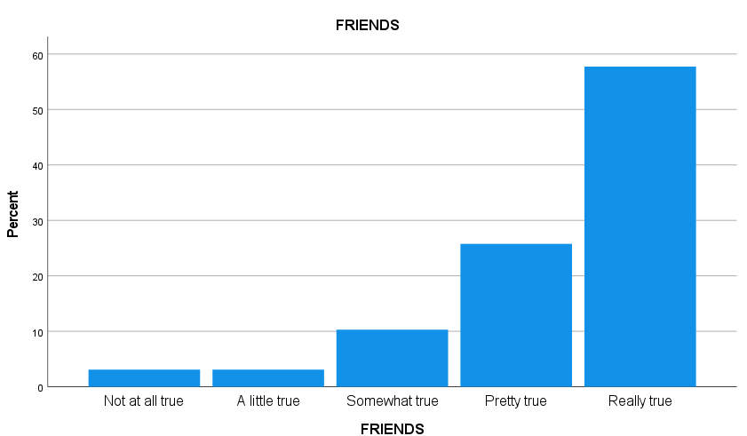
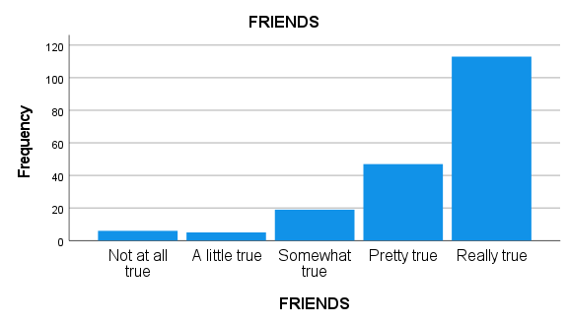
I have classmates I can become friends with. (FRIENDS)
Pre-survey Results

Slide 10

I have classmates I can become friends with. (FRIENDSP)
Post-survey Results

Slide 11
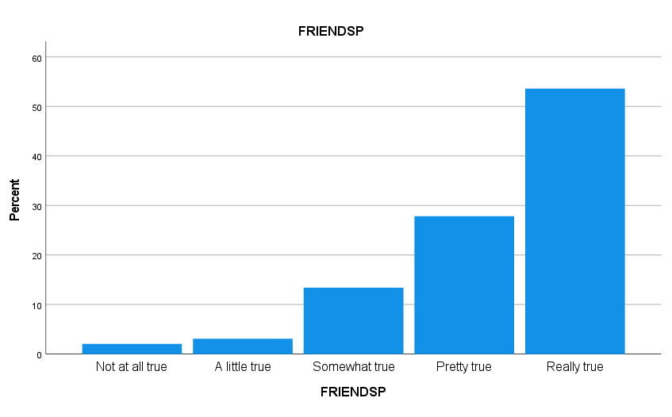
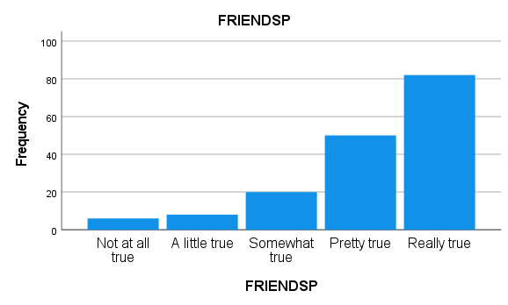
I have classmates I can become friends with. (FRIENDSP)
Post-survey Results

Slide 12
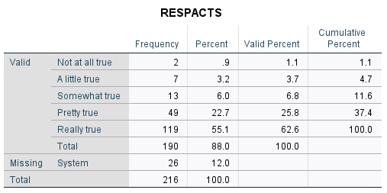

I accept responsibility for my actions. (RESPACTS)
Pre-survey Results

Slide 13
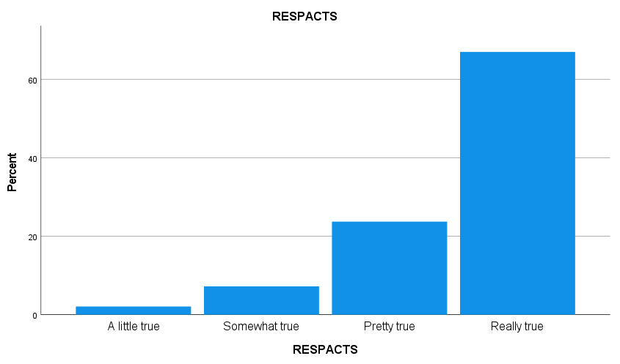
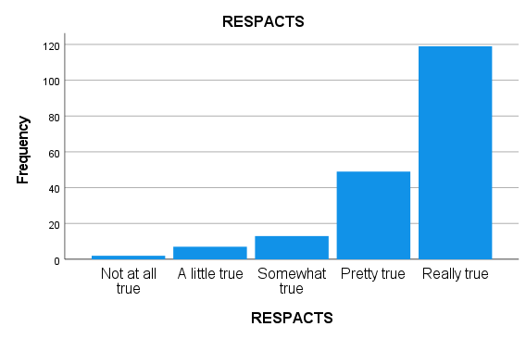
I accept responsibility for my actions. (RESPACTS)
Pre-survey Results

Slide 14
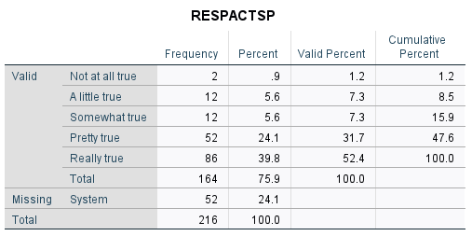
I accept responsibility for my actions. (RESPACTSP)
Post-survey Results

Slide 15
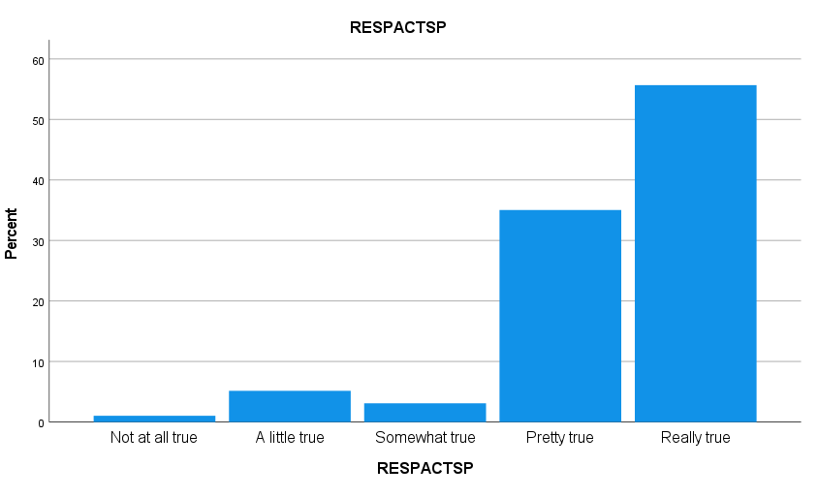
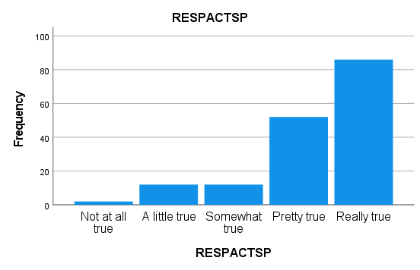
I accept responsibility for my actions. (RESPACTSP)
Post-survey Results

Slide 16

I am happy the way I am. (HAPPYAM)
Pre-survey Results

Slide 17
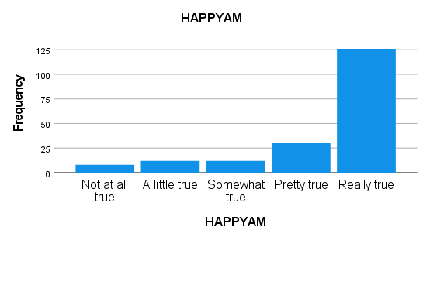
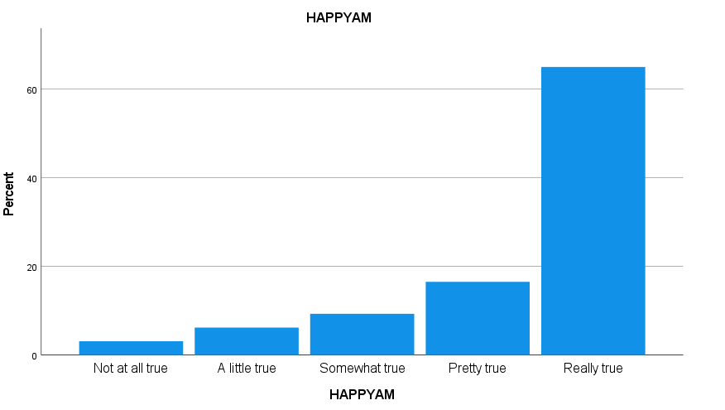
I am happy the way I am. (HAPPYAM)
Pre-survey Results

Slide 18

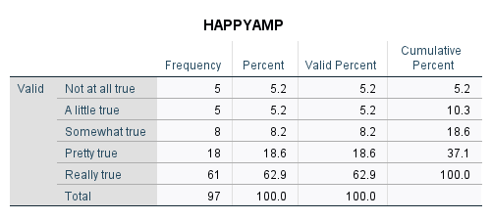
I am happy the way I am. (HAPPYAMP)
Post-survey Results

Slide 19
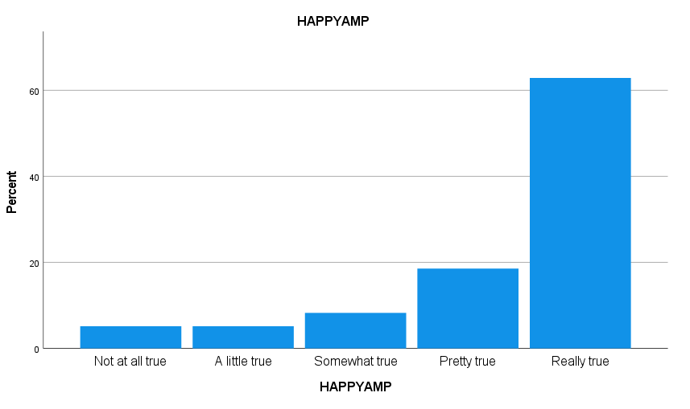
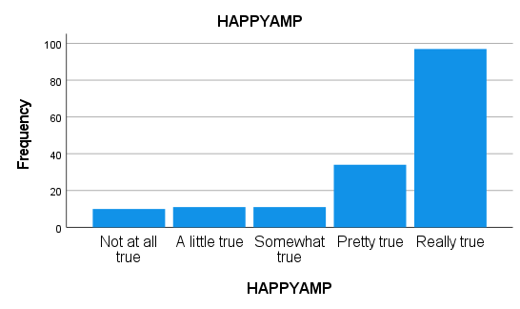
I am happy the way I am. (HAPPYAMP)
Post-survey Results

Slide 20
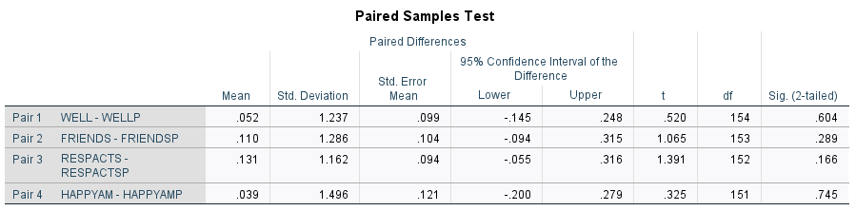
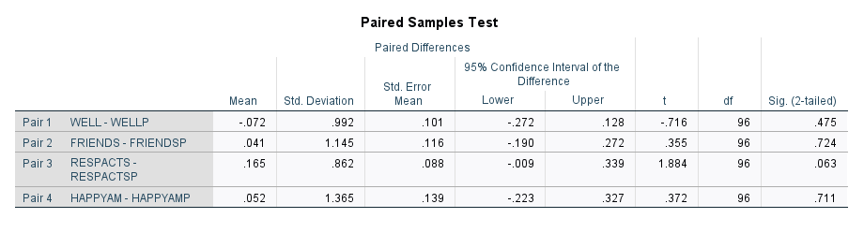
T-test Results (Pre vs. Post Survey Results)

Slide 21
Conclusion
Pre-program results are relatively optimistic regarding these four specific variables
Even with the removal of missing data points, there is no substantial change
Only post-survey response with an increase in the mean is “I think I could do well at just about any new physical activity” [WELL]

Slide 22
Questions?

